Slide 1
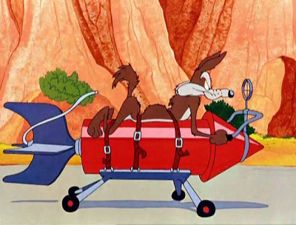
What can Wile E Coyote teach me
(about physics)

Slide 2
Who is Wile E Coyote?

Slide 3
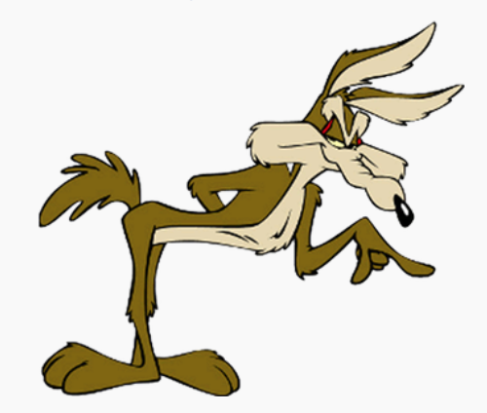
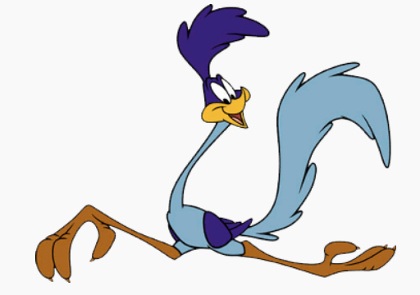
“Wile E. Coyote (also known simply as "The Coyote") and The Road Runner are a duo of characters from the Looney Tunes and Merrie Melodies series of cartoons. In the cartoons, Coyote repeatedly attempts to catch and subsequently eat the Road Runner, a fast-running ground bird, but is never successful. (wikipedia)
Unlike real coyotes, Wile E Coyote makes complex plans and uses various contraptions and performs feats of engineering none of which help him in the slightest

Slide 5
How can we learn from Wile E Coyote
Sometimes the physics he demonstrates is completely correct
Sometimes the physics gets to the heart of our students misconceptions
Sometimes the physics is so frighteningly wrong that it becomes instructive
Sometimes its all of the above!

Slide 6
Concept: Newton’s Third
Frighteningly wrong

Slide 7
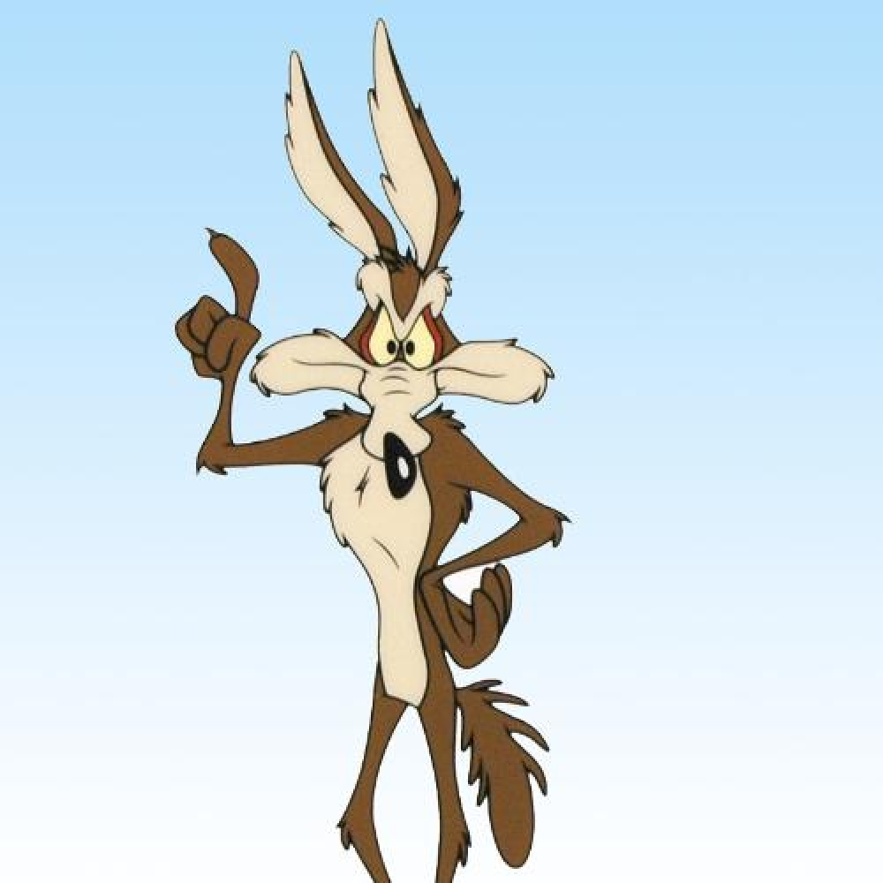
What was correct about the video?
What was incorrect?
How could this be useful?
What other topic could it be used for?

Slide 9
What was correct about the video?
What was incorrect?
How could this be useful?
What other topic could it be used for?

Slide 10
Internal vs External Forces

Slide 11
Misconception
“We walk because of our feet push us forward”
Our feet do not apply an external force on us.
Students need to understand that ONLY external forces matter.
It is the external force of the ground on our feet that push us forward.

Slide 13
Internal vs External Forces
What are the pairs of forces involved in this clip?
Propeller on water (back)
Water on propeller (forward)
Water on tub (back)
Tub on water(forward)
Which are external to the motor tub cart?
2 and 4
Why shouldn’t this work?
Opposite directions

Slide 15
Internal vs External Forces
What are the pairs of forces involved in this clip?
fan on air (forward)
Air on fan(back)
Air on sail (forward)
Sail on air(back)
Which are external to the skateboard sail cart?
2 and 4
Why shouldn’t this work?
Opposite directions

Slide 16
How to Sail

Slide 17
Physics of Sailing
Explain the motion of Wile E using either
1. Forces
2. Pressure

Slide 18
Planning (Engineering)
Wile E likes to plan

Slide 19
What’s wrong with this picture?

Slide 20
Helium Bomb

Slide 21
Misconception
What misconception does the image demonstrate?
The coyote speeds up because his mass has decreased

Slide 22
simple and not so simple machines

Slide 23
Rube Goldberg
A Rube Goldberg machine is a contraption, invention, device, or apparatus that is deliberately over-engineered to perform a simple task in a complicated fashion, generally including a chain reaction. The expression is named after American cartoonist and inventor Rube Goldberg (1883–1970)
(wikipedia)

Slide 24
Rube Goldberg

Slide 25
Fire Hose Ride

Slide 26
Which of the following statements is true about the water leaving the hose?
A) the pressure increases and the speed decreases
B) the pressure increases and the speed increases
C) the pressure decreases and the speed decreases
D) the pressure decreases and the speed increases

Slide 27
Which of the following explain the origin of the force on the hose?
A)Newton’s 2nd law
B)Newton’s 3rd law
C)Bernouilli’s principle
D)All of the above
E)Two of the above

Slide 28
Conservation of Momentum

Slide 29
What is the momentum of the ball , cannon and car before the cannon is fired?
Zero
What is the momentum of the ball , cannon and car after the cannon is fired
Zero
Is the momentum of the ball, cannon and car zero after the ball changes direction?
No
Explain why

Slide 30
A Cannon Again

Slide 31
What’s right about this video?
What’s wrong about the video?

Slide 32
Newton’s First

Slide 33
List two ways that the cartoon demonstrates Newton’s first law

Slide 34
Energy Transformations

Slide 36
Write an energy transformation equation for the grenade

Slide 38
Write an energy transformation equation for the truck

Slide 39
One last one!

Slide 40
Discuss

